Slide 1
Etelebou Routine Flaring Elimination
Basic Reasons why it is not under implementation
Project was not funded in OP21 and OP22
Cost of execution of the project is relatively high; estimated cost is $5.98Mln
Relatively low volume of oil to be protected; circa 1.1kbopd that accounts for 4.3MMscf/d flare
Given the competing demands in OP22, project was put out of plan for re-introduction in OP23
Opportunities/Positive Decision Drivers
Besides the main benefit of Routine Flaring elimination and reduction in Opex for running of the station, the following are upsides:
DED already completed
Current oil price (>$75/bbl) will make for early payback; within circa 2yrs
There is large Gas Cap in Etelebou which is planned for blow down from 2031, with FID in 2026
0.7Bscf to be developed with production of 250MMscf/d
Need to bring the shut-in wells back into production to produce the oil in readiness for the blow down
The produced associated gas will add to export gas
Key Enablers for Implementation in 2023
Support for funding ($6M)
Inclusion in OABP plan for 2023 (execution capacity)

Slide 2
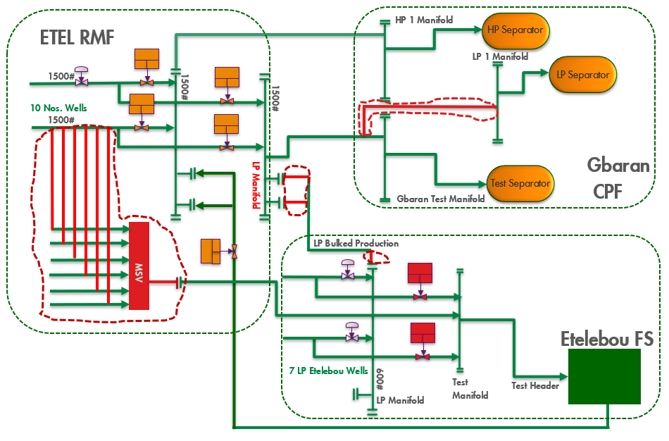
Etelebou Routine Flaring Elimination
Etelebou Wells Rerouting to Gbaran CPF
Bulk all LP wells at the Flowstation from the FS LP Header to the new LP Manifold at the Remote Manifold en-route to Gbaran CPF using the existing 4-inch Line for Well 7S with end tie-in modifications
Carry out Monthly well testing of the Flowstation LP wells at the Flowstation using the Flowstation Test Header.
Install a Multiport Selector Valve at the Etelebou Remote Manifold for rerouting the HP wells to the flowstation for testing of the wells using existing 4-inch line for Well 7L with end-tie-in modification
Carry out monthly well testing of the Remote Manifold HP wells at the adjacent Etelebou flowstation.
Carry out modifications to install Multiphase Meters for Metering of the Well Fluids, this will eventually replace the use of the flowstation for well testing and ensure that flowstation can be completely decommissioned for use ultimately with multiphase meters used for testing
At Gbaran CPF;
Convert HP1 Oil Header to LP2 oil header
Reroute 6” Test Line (On-plot piping) from Test Manifold to the Oil Train LP Header
Scope
Convert the 6” Existing Test Manifold and Line at Etelebou Remote Manifold to an LP manifold and line.

Slide 4
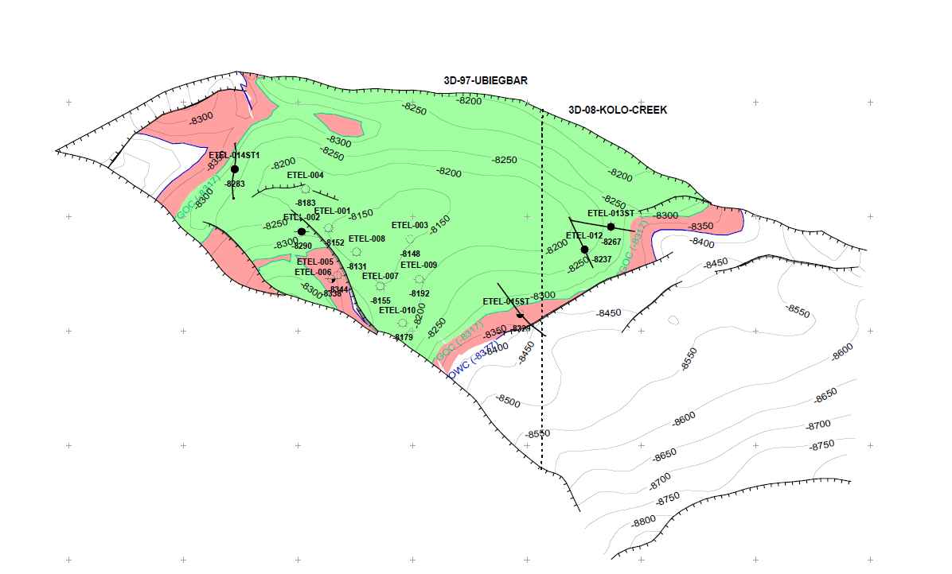
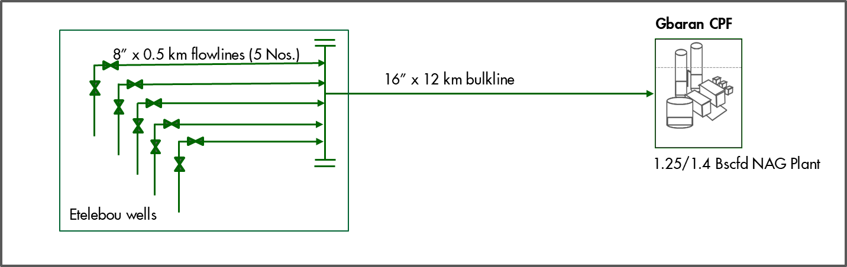
Etelebou CDE Reservoirs Development
From Supply Planning and Forecasting Team
PROJECT OBJECTIVE & JUSTIFICATION | This project is aimed at keeping the Gbaran facility full by developing 659 Bscf of gas from C9200N, C9400N, D8000N and E1000N reservoirs with a total potential of about 250 MMscf/d Select phase maturation as part of NSA studies
PROJECT SUMMARY | Drill and complete 5 Gas wells Install 5Nos new 8" x 500m DSS Flowline to new remote manifold at Etelebou Install 16"x12km CS bulkline to Gbaran CPF Tie-in at existing Gbaran CPF vis xxx Sludge Catcher
PROJECT METRICS | CAPEX (MOD 100%) = $342mln (Well: $195mln & Facilities: $147mln) FID: Oct-26 Start-up: Jun-31
OPEN SWITCHES | Readiness of reservoirs for gas cap blowdown. PIA regulation on gas cap destination

